Slide 1
DESIGN AND VERIFICATION TIMER IP

Slide 2
01
Introduction
02
Design Specification
03
RTL Design
04
Design Verification
05
Simulation Result
CONTENTS

Slide 3
CONTENT
Introduction

Slide 4

INTRODUCTION
▪ Timer is an essential module for every chip.
▪ This is used to generate accurate timing interval or controlling the timing of various operations within the circuit. Timer can be used in various application: pulse generation, delay generation, event generation, PWM generation, Interrupt generation ….
▪ In this project, a timer module is customized from CLINT module of industrial RISC-V architecture. It is used to generate interrupt based on user settings.

Slide 5
CONTENT
2. Design Specification
2.1 Feature list
2.2 Register specification

Slide 6
2.1 Timer Features
The timer has following features:
64-bit count-up.
Address space: 4KB (0x4000_1000 – 0x4000_1FFF).
Register set is configured via APB bus (IP is APB slave).
Support wait state (1 cycle) and error handling.
Support byte access.
Support halt (stop) in debug mode.
System clock frequency is 200 MHz. Timer uses active low async reset.
Counter can be counted based on system clock or divided up to 256.
Support timer interrupt (can be enabled or disabled).

Slide 7
Detail Functional Description – Counter
The counter specification is described as following:
64-bit count-up.
Counting mode:
Default mode: counter’s speed is same as system clock.
Control mode: when enabled by writing 1 to TCR.div_en bit, the counter's speed is determined by the divisor value set in TCR.div_val.
Counter continues counting when interrupts occurs.
Counter continues counting when overflow occurs.
Support halted mode.
When timer_en changes from High to Low, the counter is cleared to its initial value. When timer_en transitions back from Low to High again, timer can work normally.
Note: the div_en and div_val is not related to frequency divisor (clock divider). Those settings only control the counter when to count.

Slide 8
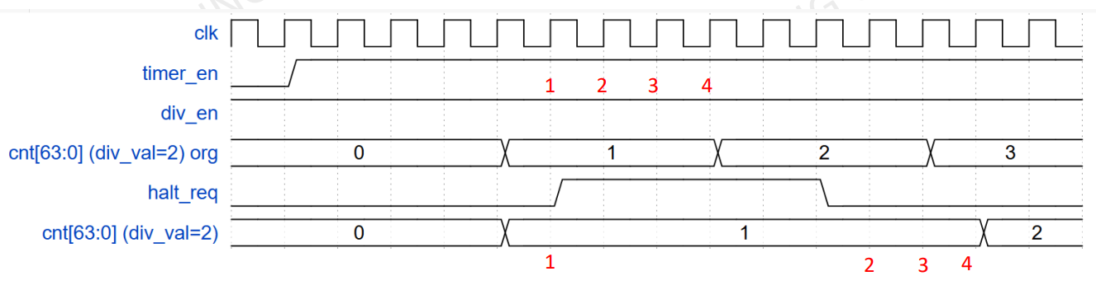
Detail Functional Description – Halted
Halt mode:
Counter can be halted (stopped) in debug mode when both below conditions occur:
Input debug_mode signal is High.
THCR.halt_req is 1.
THCSR.halt_ack is 1 after a halt request indicates that the request is accepted.
After halted, counter can be resumed to count normally when clearing the halt request to 0.
The period of each counting number needs to be the same when halt and not halt as described in the below waveform example (div_val = 2).

Slide 9
Detail Functional Description – Timer Interrupt
Timer interrupt:
Timer interrupt (tim_int) is asserted (set) when interrupt is enabled and counter’s value matches (equal) the compare value.
Once asserted, the timer interrupt (tim_int) remains unchange until it is cleared by writing 1 to TISR.int_st bit or the interrupt is disabled.

Slide 10
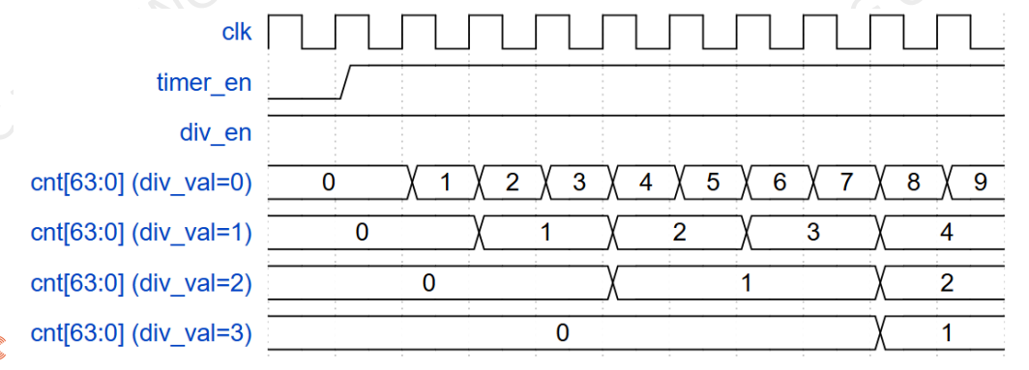
Detail Functional Description – Counting Mode
Counting mode:
In default mode, counting speed depend on system clock (same as div_val = 0 case as below waveform).
The counting’s speed can be controlled by register settings by setting into TCR.div_en and TCR.div_val [3:0] as the register specification.
div_en and div_val cannot be changed during timer_en is High.
Not allow to change div_en and div_val while timer_en is High by an error response when user mistakenly accesses.
Example waveform of counter in control mode.

Slide 11
2.2 Detail Functional Description – APB slave / Register
APB slave / Register:
Address space: 4KB (0x4000_1000 – 0x4000_1FFF).
Read/write to reserved area is RAZ/WI (read as zero, write ignored).
System clock frequency is 200 MHz.
Support byte access: bus can access to individual bytes in the register.
Support wait state (1 cycle) to improve the timing.
Support error handling for some prohibited access:
write prohibited value to TCR.div_val.
div_en or div_val changes during timer is operating.
When error occurs, data is not written into register bits/fields.

Slide 12
REGISTER SUMMARY
Base address: 0x4000_1000
Offset | Abbreviation | Register name
0x00 | TCR | Timer Control Register
0x04 | TDR0 | Timer Data Register 0
0x08 | TDR1 | Timer Data Register 1
0x0C | TCMP0 | Timer Compare Register 0
0x10 | TCMP1 | Timer Compare Register 1
0x14 | TIER | Timer Interrupt Enable Register
0x18 | TISR | Timer Interrupt Status Register
0x1C | THCSR | Timer Halt Control Status Register
Others | Reserved

Slide 13
Timer Control Register (TCR)
Bit | Name | Type | Default value | Description
31:12 | Reserved | - | 20’h0 | Reserved
11:8 | div_val | RW | 4’b0001 | Counter control mode setting: 4’b0000: Counting speed is not divided. 4’b0001: Counting speed is divided by 2 (default). 4’b0010: Counting speed is divided by 4. 4’b0011: Counting speed is divided by 8. 4’b0100: Counting speed is divided by 16. 4’b0101: Counting speed is divided by 32. 4’b0110: Counting speed is divided by 64. 4’b0111: Counting speed is divided by 128. 4’b1000: Counting speed is divided by 256. Others: reserved, prohibit settings. When setting the prohibit value, div_val is not changed. Note: User must not change div_en while timer_en is High. Add hardware logic to ensure div_val is prohibited to change when timer_en is High. Access is error response in this case. Access is “error response” when setting prohibit value to div_val.
7:2 | Reserved | RO | 6’b0 | Reserved
1 | div_en | RW | 1’b0 | Counter control mode enable. 0: Disabled. Counter counts with normal speed based on system clock. 1: Enabled. The couting speed of counter is controlled based on div_val. Note: User must not change div_en while timer_en is High. Add hardware logic to ensure div_en is prohibited to change when timer_en is High. Access is error response in this case.
0 | timer_en | RW | 1’b0 | Timer enable 0: Disabled. Counter does not count. 1: Enabled. Counter starts counting. Timer_en changes from H->L will initialize the TDR0/1 to their initial value.

Slide 14
Timer Data Register 0 (TDR0)
Bit | Name | Type | Default value | Description
31:0 | TDR0 | RW | 32’h0000_0000 | Lower 32-bit of 64-bit counter. Value of this register is cleared to initial value when timer_en changes from H->L.

Slide 15
Timer Data Register 1 (TDR1)
Bit | Name | Type | Default value | Description
31:0 | TDR1 | RW | 32’h0000_0000 | Upper 32-bit of 64-bit counter. Value of this register is cleared to initial value when timer_en changes from H->L.

Slide 16
Timer Compare Register 0 (TCMP0)
Bit | Name | Type | Default value | Description
31:0 | TCMP0 | RW | 32’hFFFF_FFFF | Lower 32-bit of 64-bit compare value. Interrupt is asserted when counter value is equal to compare value.

Slide 17
Timer Compare Register 1 (TCMP1)
Bit | Name | Type | Default value | Description
31:0 | TCMP1 | RW | 32’hFFFF_FFFF | Upper 32-bit of 64-bit compare value. Interrupt is asserted when counter value is equal to compare value.

Slide 18
Timer Interrupt Enable Register (TIER)
Bit | Name | Type | Default value | Description
31:1 | Reserved | RO | 31’h0 | Reserved
0 | int_en | RW | 1’b0 | Timer interrupt enable 0: Timer interrupt is disabled. 1: Timer interrupt is enabled. When this bit is 0, no timer interrupt is output. When this bit is 1, timer interrupt can be output when reaching trigger condition. Clearing this bit to 0 while interrupt is asserting will mask the interrupt to 0 but does not affect the interrupt pending bit TISR.int_st bit.

Slide 19
Timer Interrupt Status Register (TISR)
Bit | Name | Type | Default value | Description
31:1 | Reserved | RO | 31’h0 | Reserved
0 | int_st | RW1C | 1’b0 | Timer interrupt trigger condition status bit (interrupt pending bit) 0: the interrupt trigger condition does not occur. 1: the interrupt trigger condition occurred. Write 1 when this bit is 1 to clear it. Write 0 when this bit is 1 has no effect. Write to this bit when it is 0 has no effect. Note: When interrupt trigger condition occurred (counter reached compare value), counter continues to count normally.

Slide 20
Timer Halt Control Status Register (THCSR)
Bit | Name | Type | Default value | Description
31:2 | Reserved | RO | 30’h0 | Reserved
1 | halt_ack | RO | 1’b0 | Timer halt acknowledge 0: timer is NOT halted 1: timer is halted Timer accepts the halt request only in debug mode, indicates by debug_mode input signal.
0 | halt_req | RW | 1’b0 | Timer halt request 0: no halt req. 1: timer is requested to halt.

Slide 21
CONTENT
3. RTL Design
3.1 Block diagram
3.2 I/O Port list
3.3 Logic diagram
3.4 Waveform

Slide 22
3.1 I/O Port List
timer_top
Signal name | Width | Direction | Description
sys_clk | 1 | Input | Input clock signal for the timer module.
sys_rst_n | 1 | Input | Active-low asynchronous reset signal 0: The counter is in reset state 1: The counter is in non-reset state
tim_psel | 1 | Input | APB select signal to indicate the timer module is selected for a transaction.
tim_pwrite | 1 | Input | APB write control signal 0: Read operation 1: Write operation
tim_penable | 1 | Input | APB enable signal to initiate the data phase of a transaction.
tim_paddr | 12 | Input | APB address bus to specify the register address. Note: The bit-width must accommodate the address space.
tim_pwdata | 32 | Input | APB write data bus to provide data for write transactions.
tim_prdata | 32 | Output | APB read data bus to return data during read transactions.
tim_pstrb | 4 | Input | APB byte strobe signal for specifying valid write data bytes.
tim_pready | 1 | Output | APB ready signal to indicate the timer module has completed the transaction.
tim_pslverr | 1 | Output | APB error signal to indicate an invalid or unsupported transaction.
tim_int | 1 | Output | Timer interrupt signal triggered when the timer generates an interrupt.
dbg_mode | 1 | Input | Debug mode signal to enable or disable debug functionality for the timer.

Slide 23
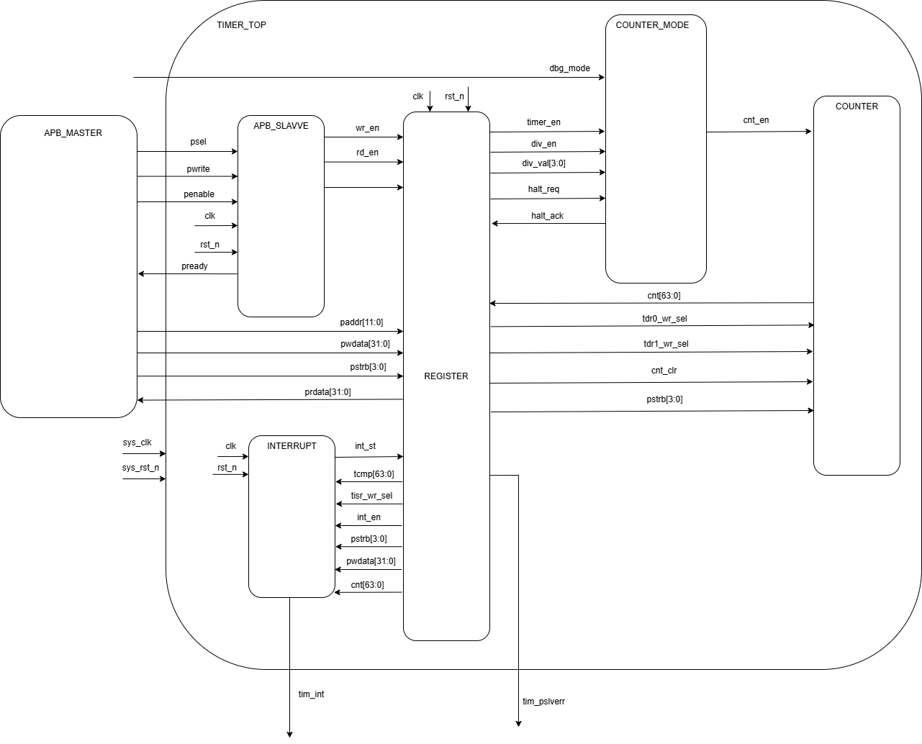
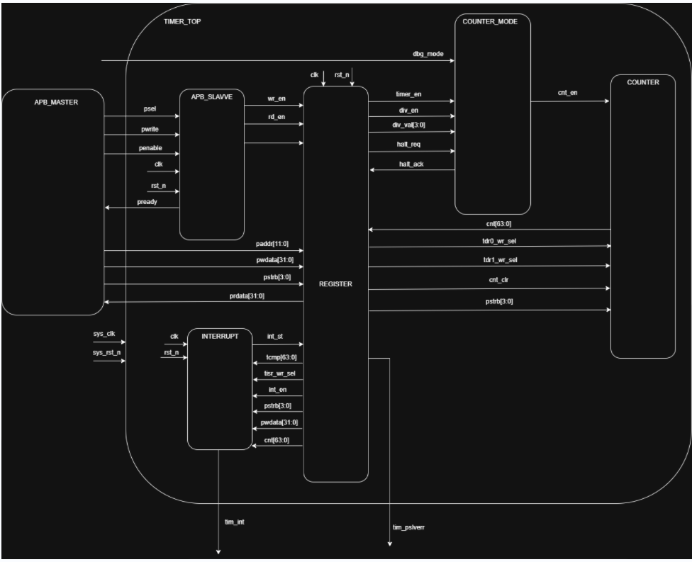
3.2 Block diagram
Block diagram of project:

Slide 24
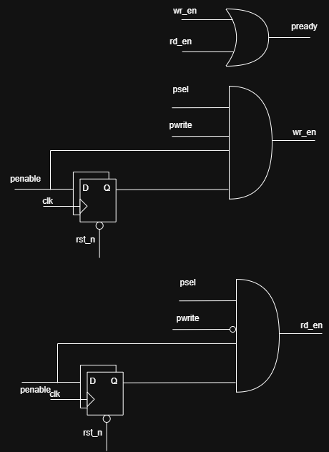
3.3 Logic diagram - APB_SLAVE
wait state 1 cycle:

Slide 25
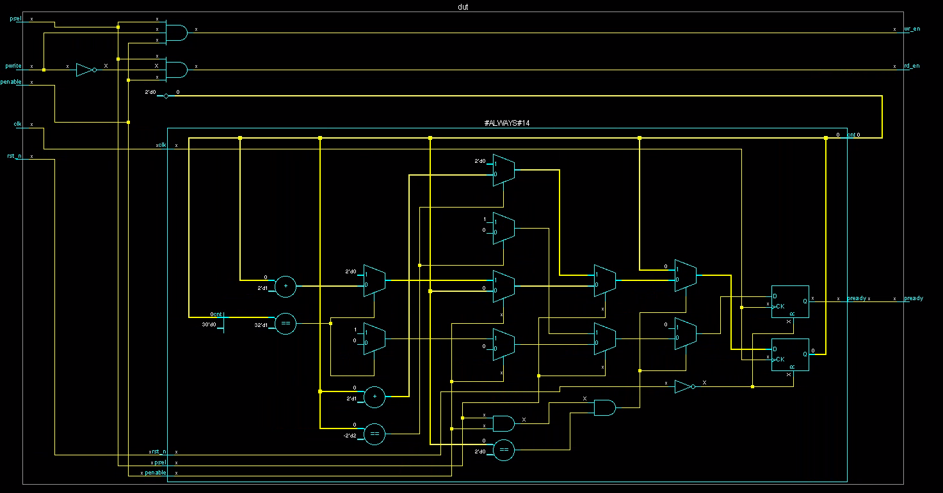
Wait state 2 (or more) cycle

Slide 26
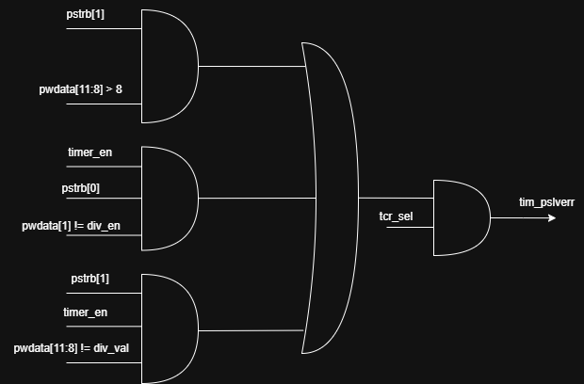
3.3 Logic diagram - REGISTER
Slave error:

Slide 27
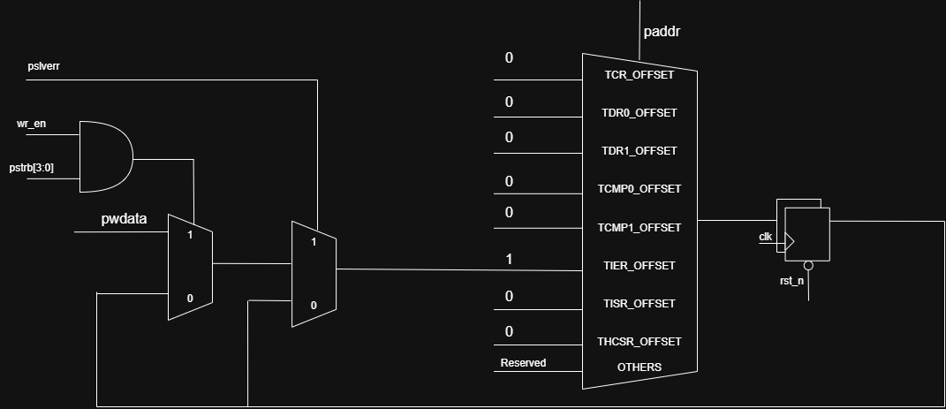
3.3 Logic diagram - REGISTER
Write tranfer:

Slide 28
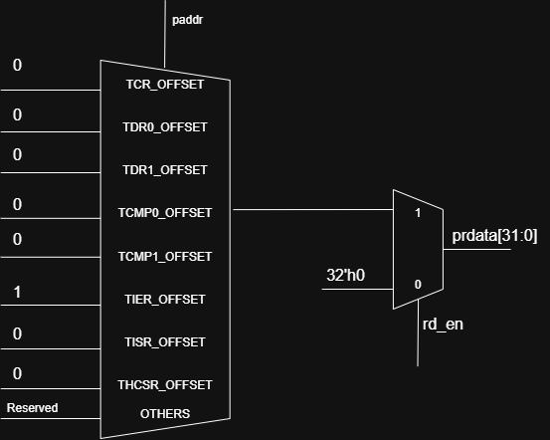
3.3 Logic diagram - REGISTER
Read tranfer:

Slide 29
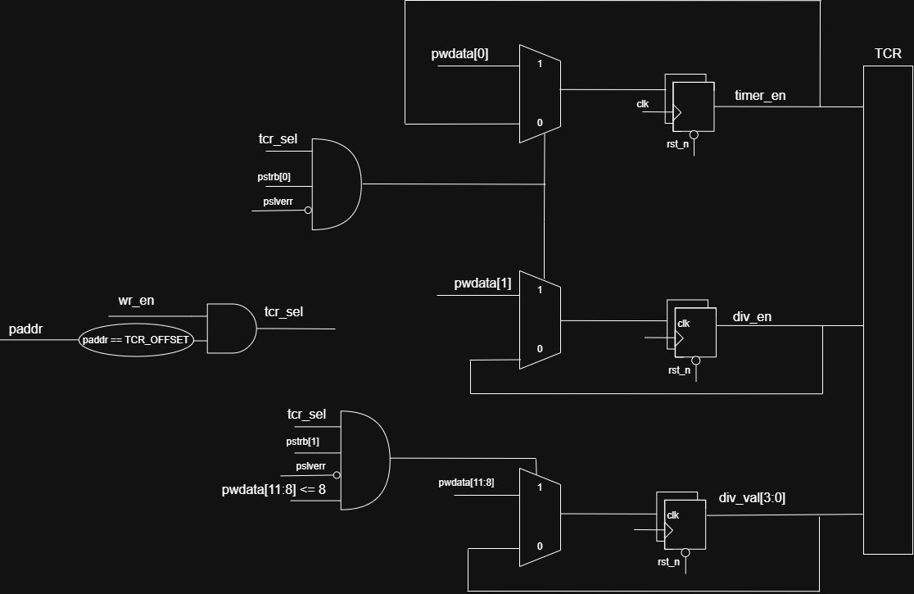
3.3 Logic diagram - REGISTER
Timer Control Register:

Slide 30
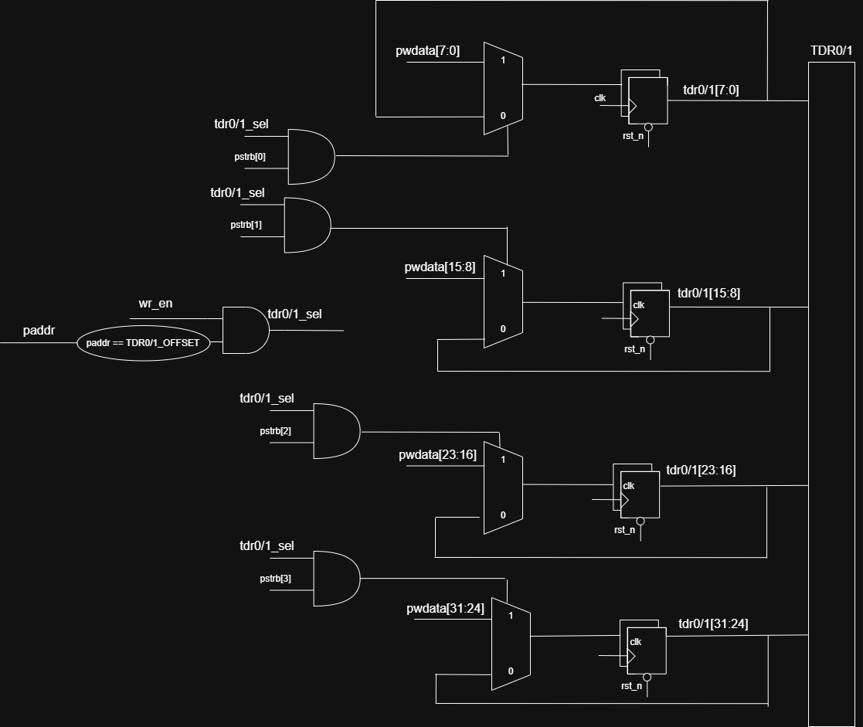
3.3 Logic diagram - REGISTER
Timer Data Register 0/1:

Slide 31
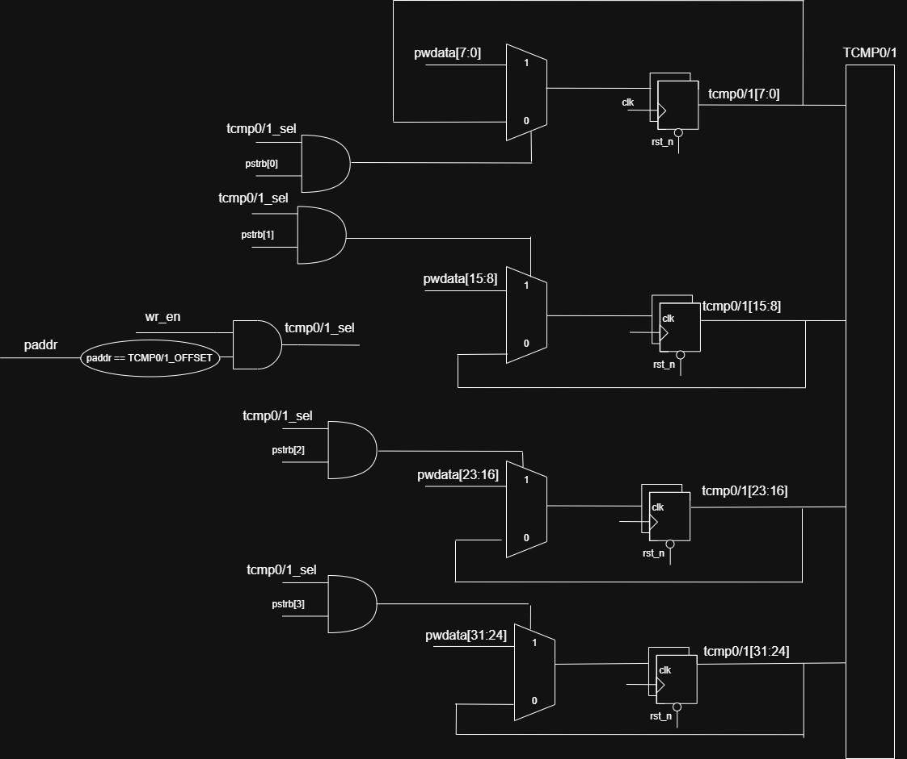
3.3 Logic diagram - REGISTER
Timer Compare Register 0/1:

Slide 32
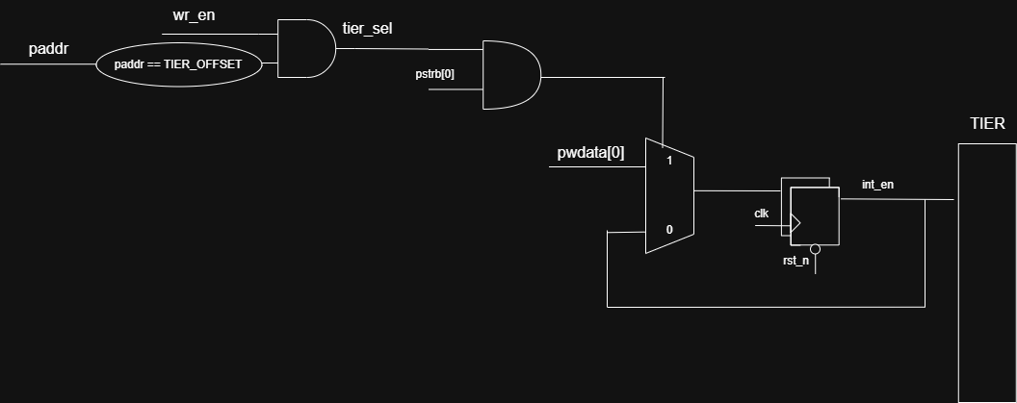
3.3 Logic diagram - REGISTER
Timer Interrupt Enable Register:

Slide 33
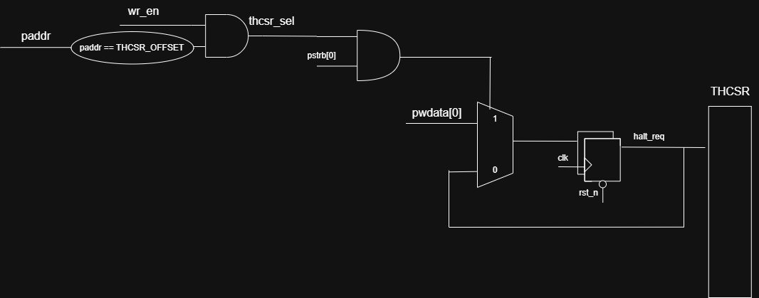
3.3 Logic diagram - REGISTER
Timer Halt Control Status Register:

Slide 34
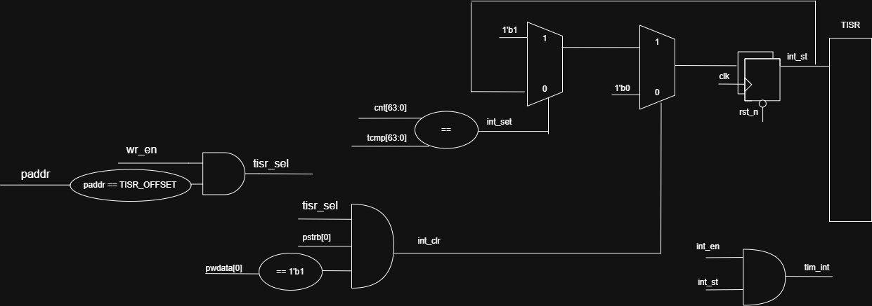
3.3 Block diagram - INTERRUPT
Timer Interrupt Status Register:

Slide 35
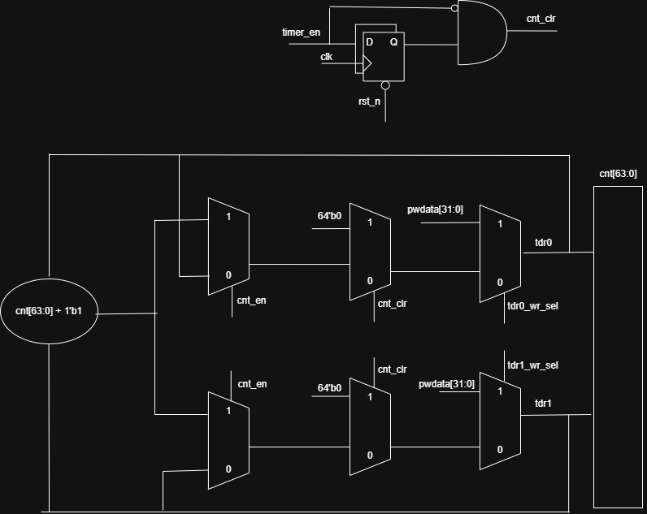
3.3 Block diagram - COUNTER
Timer Counter:

Slide 36
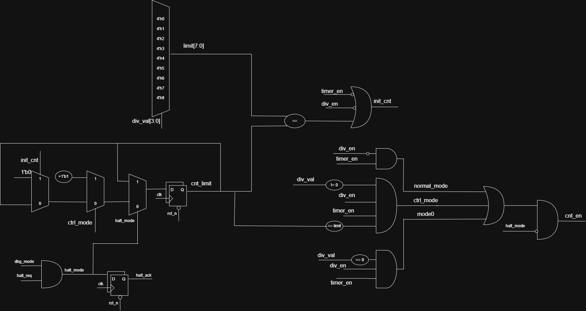
3.3 Block diagram - COUNTER_MODE
Counter Mode:

Slide 37
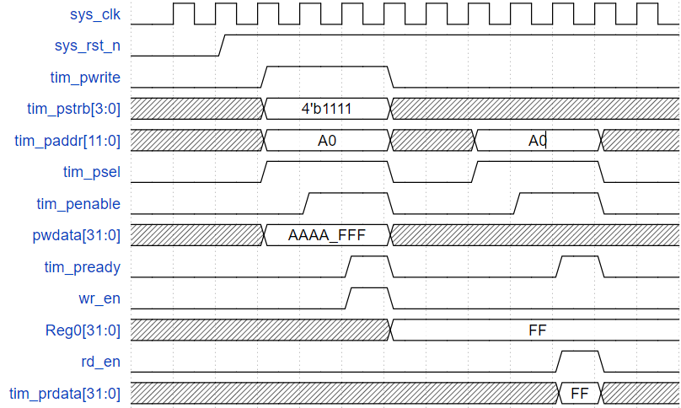
3.4 Waveform
Wait state 1 cycle:

Slide 38
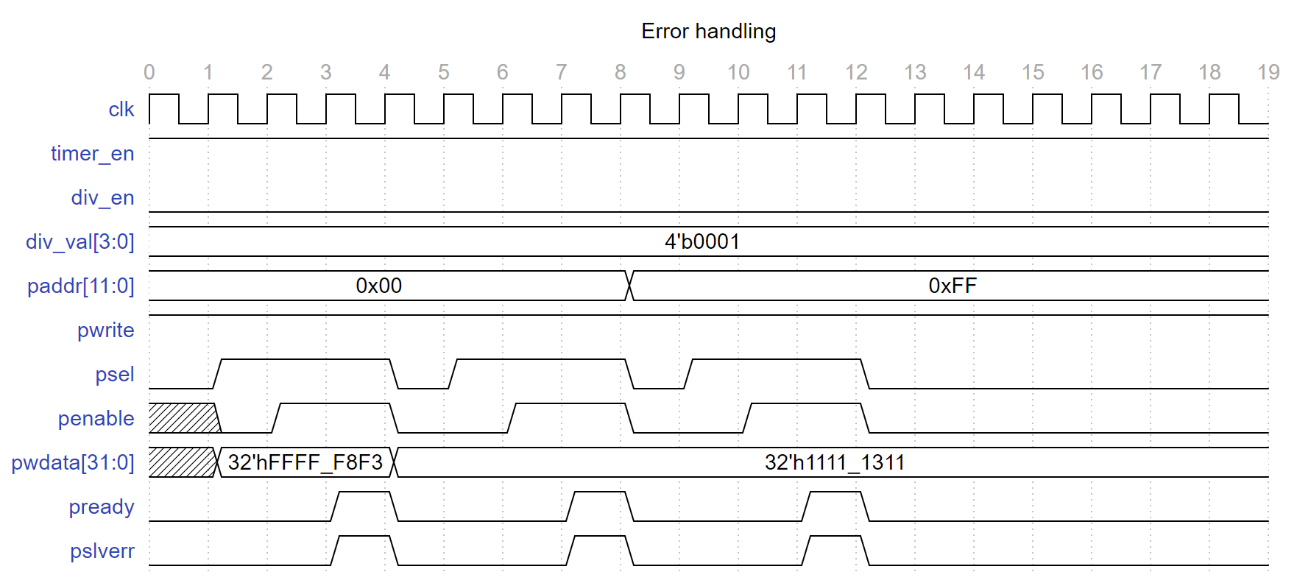
3.4 Waveform
Error handling:

Slide 39
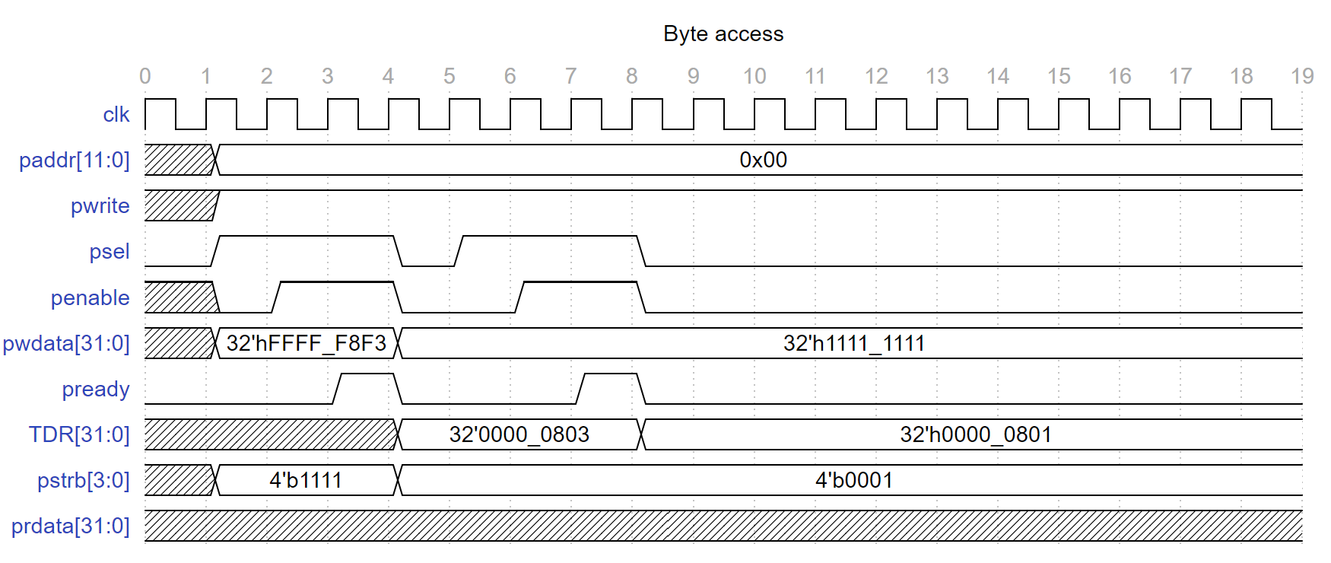
3.4 Waveform
Byte access:

Slide 40
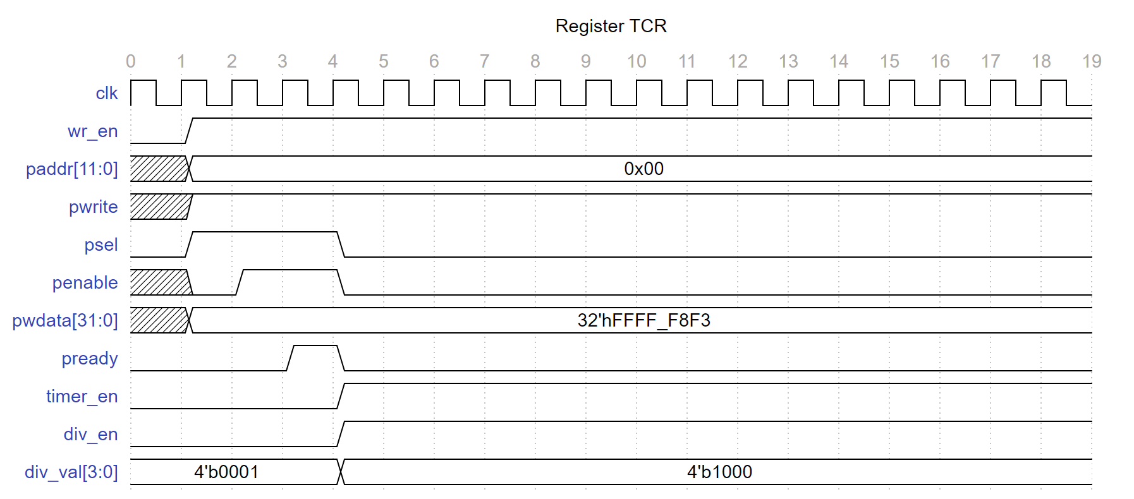
3.4 Waveform
Timer Control Register:

Slide 41
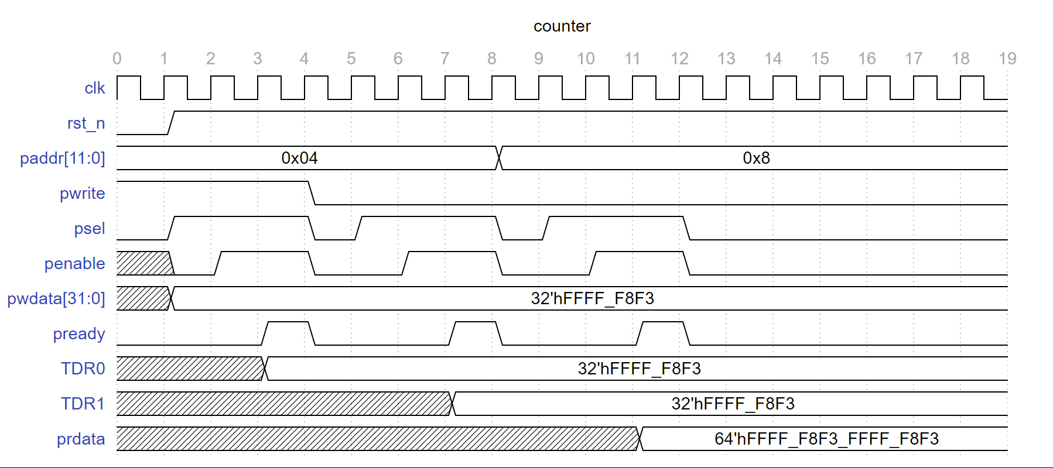
3.4 Waveform
Timer Data Register 0/1:

Slide 42
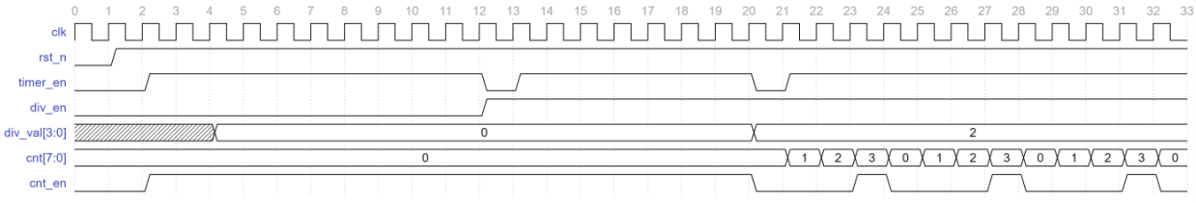
3.4 Waveform
Counter_mode:

Slide 43
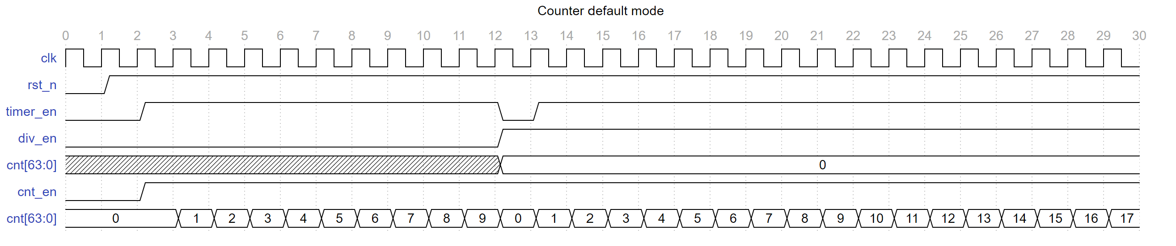
3.4 Waveform
Counter is counting up with default mode:

Slide 44
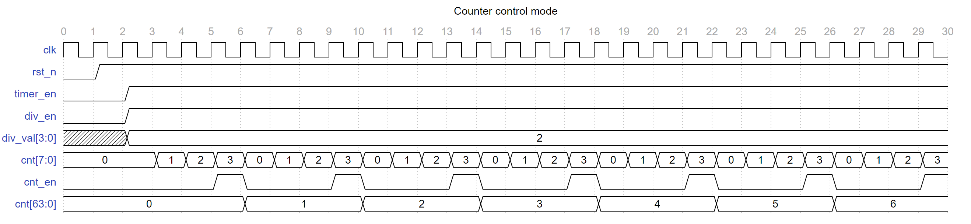
3.4 Waveform
Counter is counting up with control mode:

Slide 45
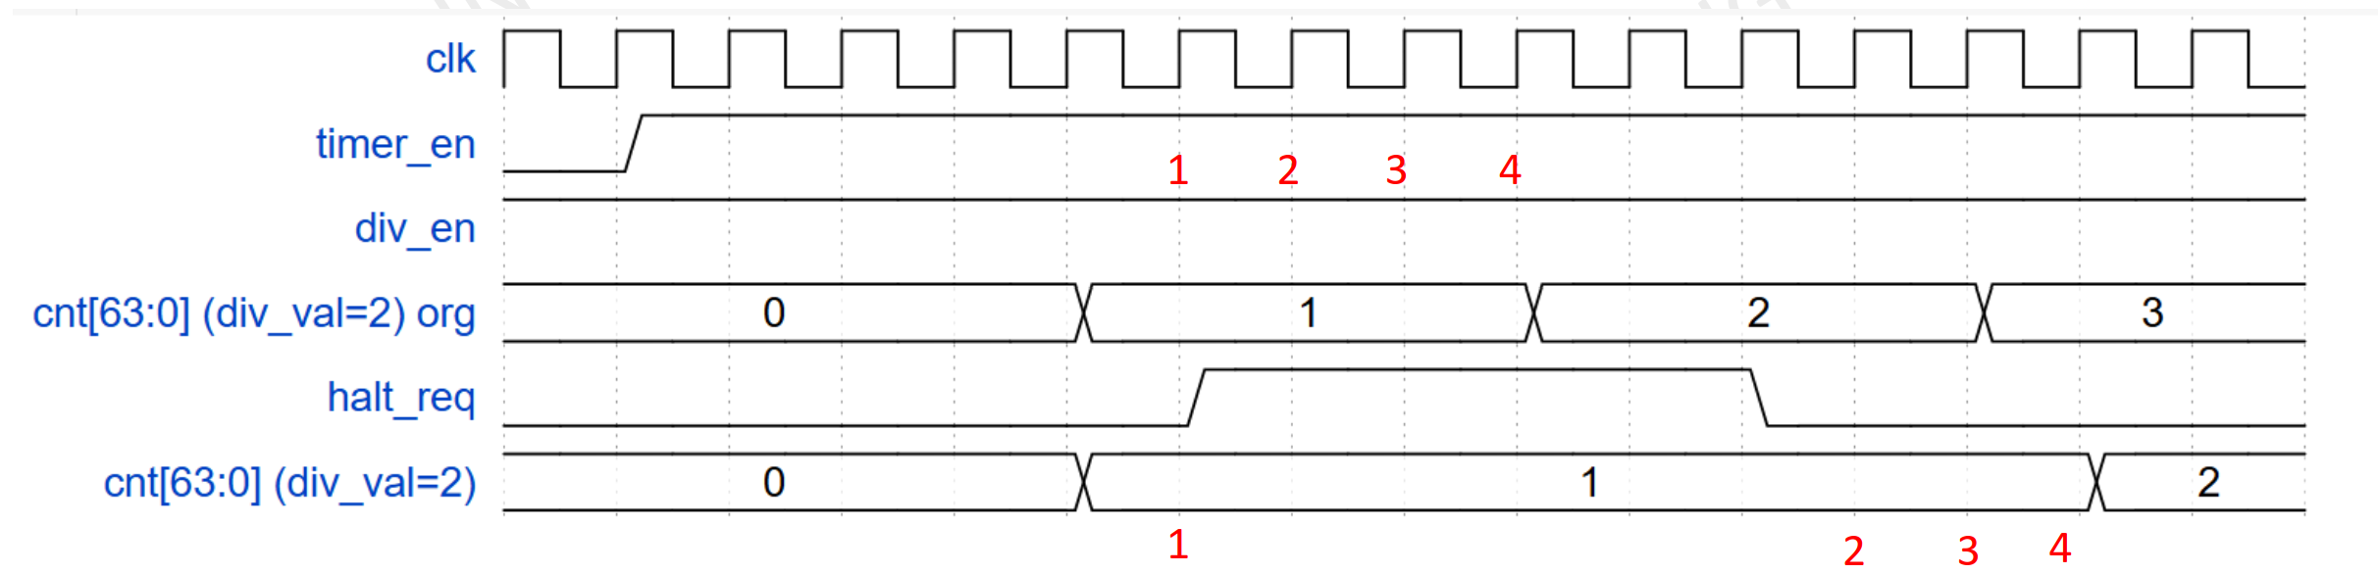
3.4 Waveform
Halt mode:

Slide 46
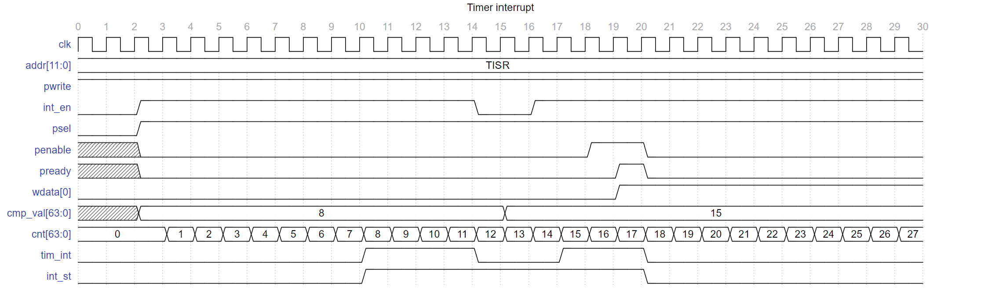
3.4 Waveform
Timer interrupt:

Slide 47
CONTENT
4. Design Verification
4.1 Verification enviroment
4.2 Check list

Slide 48
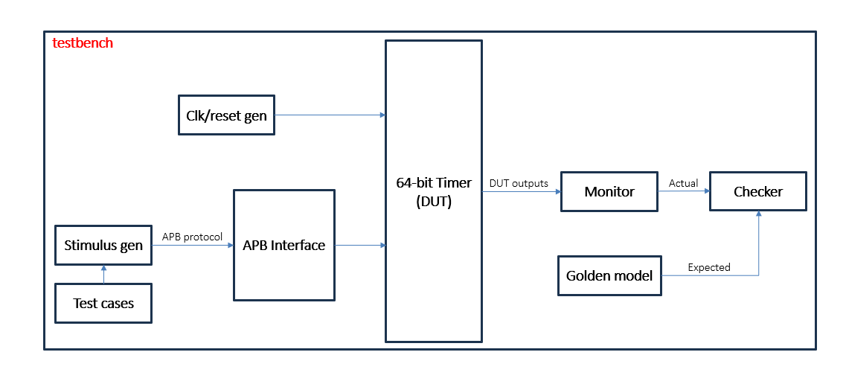
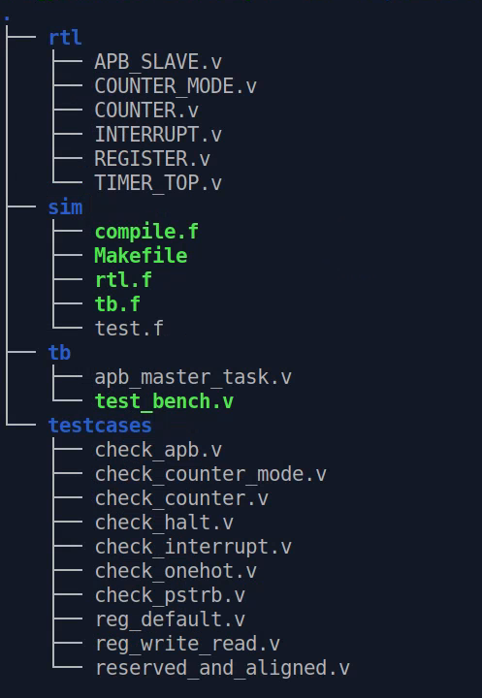
4.1 Verification enviroment

Slide 49
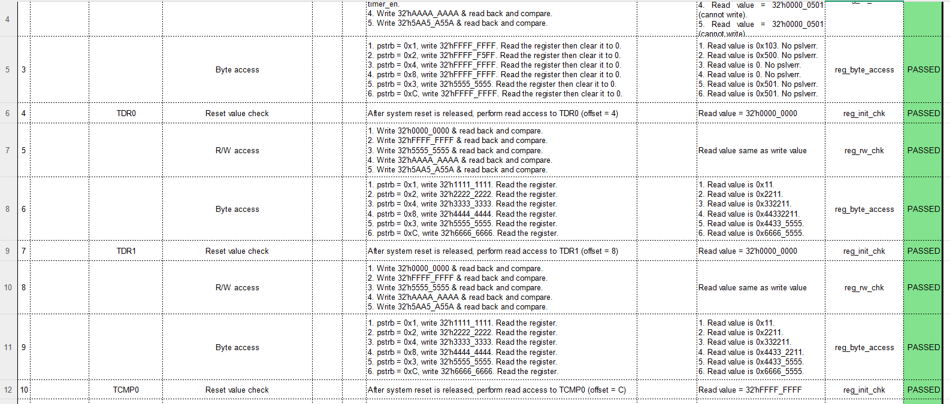
4.2 Check list
Example

Slide 50
CONTENT
5. Simulation Result
5.1 Golden model result
5.2 Coverage result

Slide 51
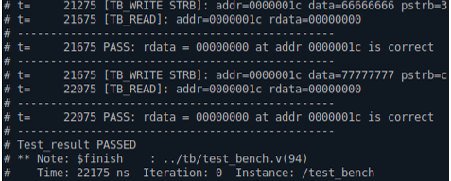
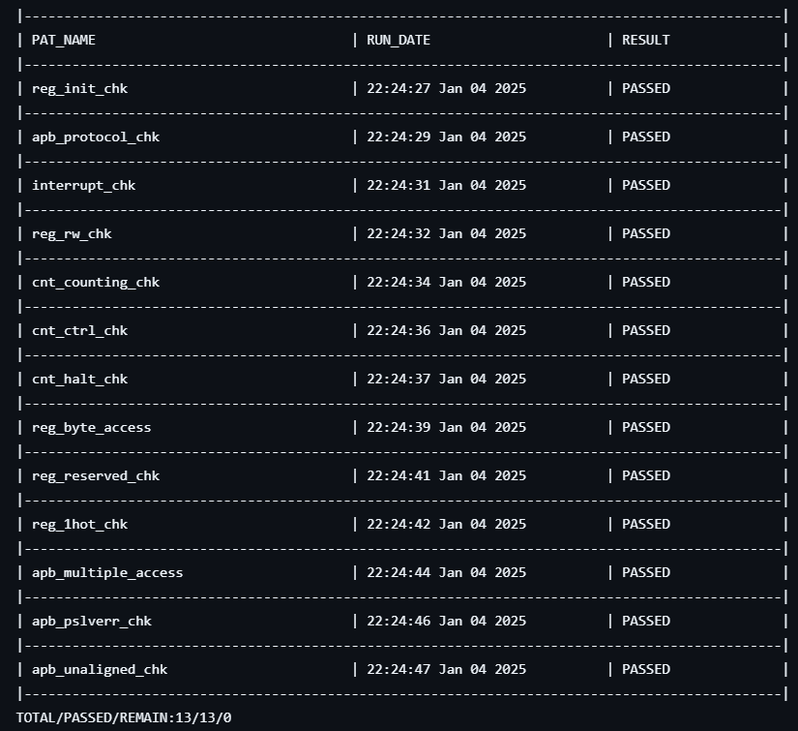
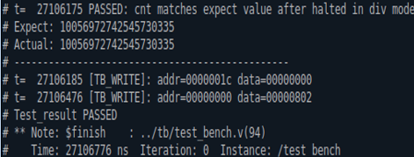
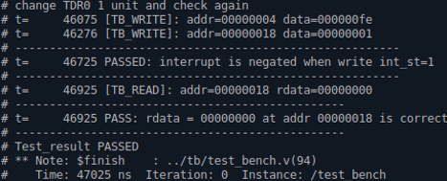
5.1 Golden model result
Example:

Slide 52
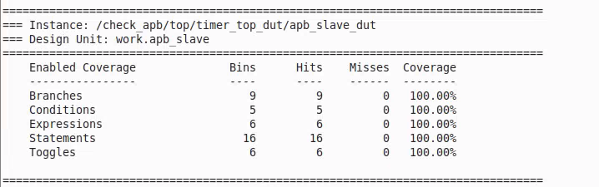
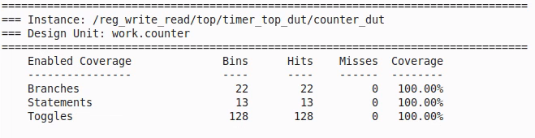
5.2 Coverage result
Coverage text reports: Achieve 100% coverage of DUT(combine “Exclusion File” (*.do) with appropriate reasons).

Slide 53
THANK YOU

